Slide 1
Cortex Inspired Spatial Processing Algorithm v2.0
2018/9/7
Kenny Chou

Slide 2
Change Log
Peripheral Filtering:
  Changed to 64 freq channels
  Increased freq range to [150,8000] Hz
IC Model
  Modified FR function (input-output curve)

Slide 3
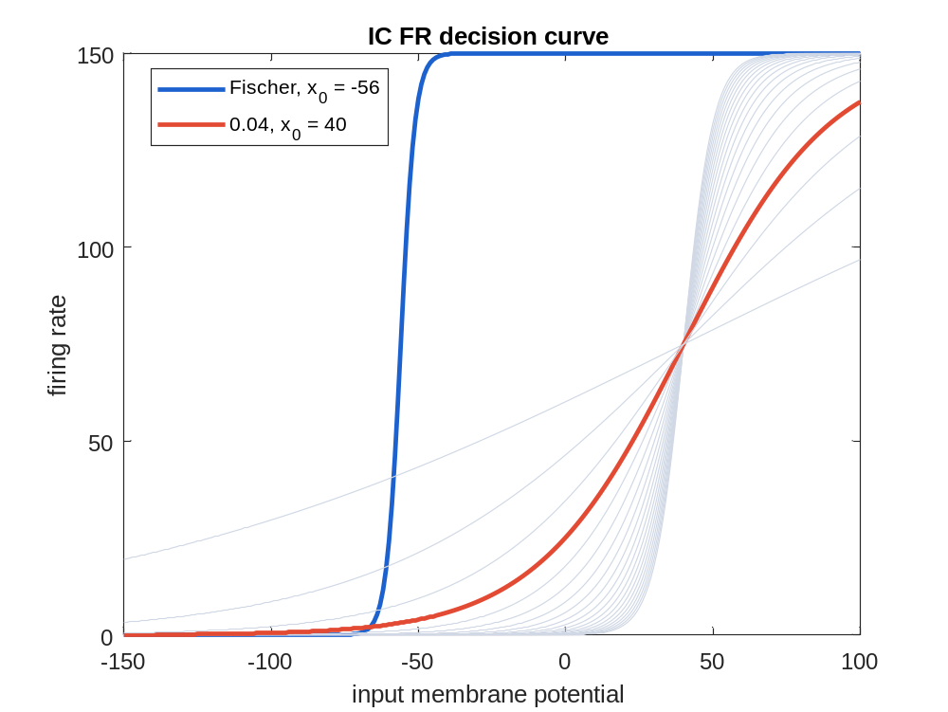
Change Log
Peripheral Filtering:
  Changed to 64 freq channels
  Increased freq range to [150,8000] Hz
IC Model
  Modified FR function
  Blue: Old
  Red : New

Slide 4
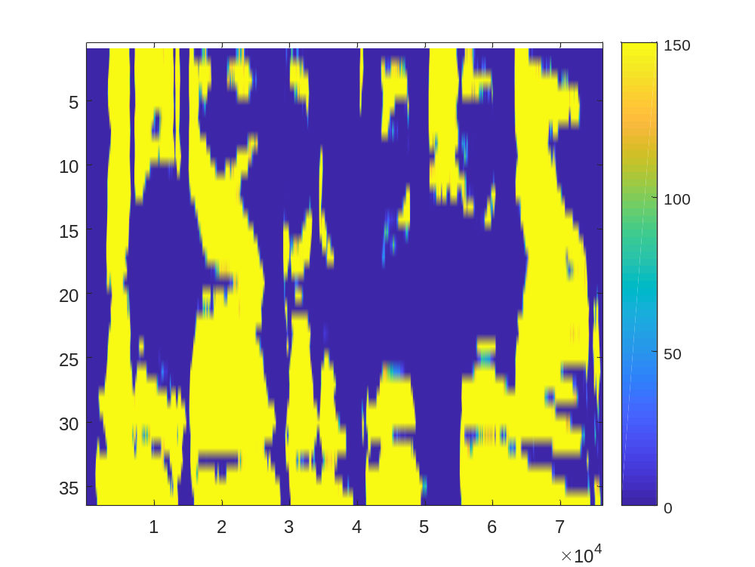
Change Log
Peripheral Filtering:
  Changed to 64 freq channels
  Increased freq range to [150,8000] Hz
IC Model
  Modified FR function
  FR Pattern: Before ->

Slide 5
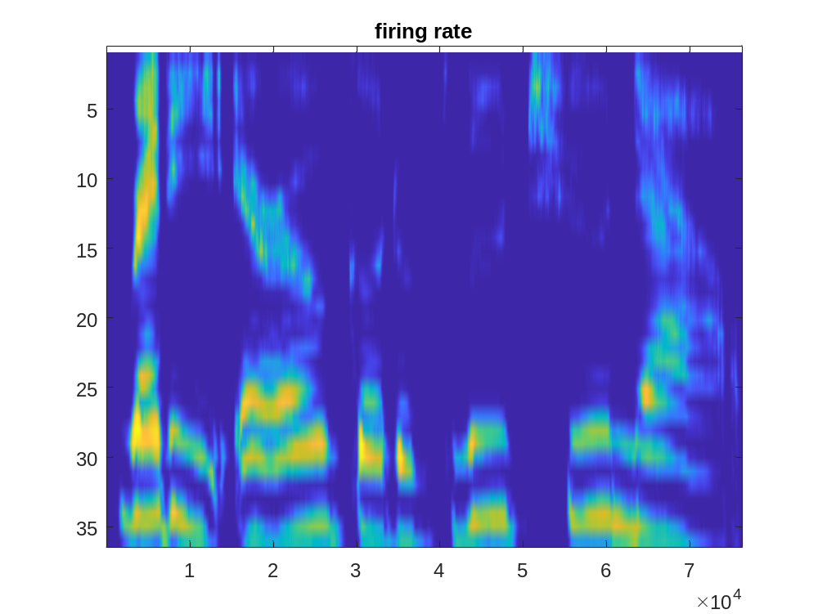
Change Log
Peripheral Filtering:
  Changed to 64 freq channels
  Increased freq range to [150,8000] Hz
IC Model
  Modified FR function
  FR Pattern: After ->

Slide 6
Change Log
Peripheral Filtering:
  Changed from 36 to 64 freq channels
  Increased freq range to [150,8000] Hz
IC Model
  Modified FR function
Added Lateral Inhibition Network
  Need to optimize Parameter
Cortical Model
  DynaSim Implementation
Reconstruction
  Changed from Linear Reconstruction to FR-based Mask Estimation
Post Processing
  Added Post Processing Modules (in progress)

